Slide 1

ALY6980
Capstone
What is your goal?
What to expect?
What is expected from you?

Slide 2
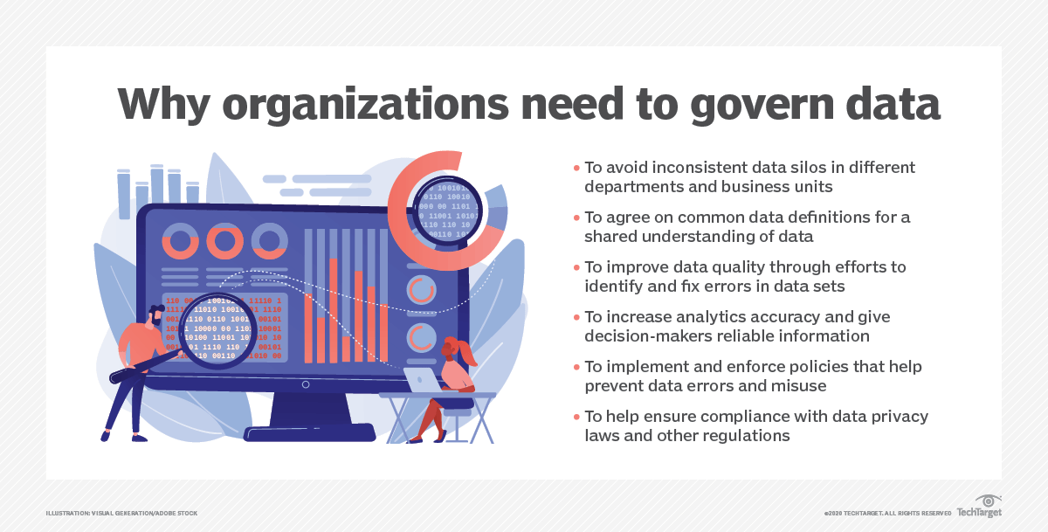
Introduction to Data Governance
Data management is the process of collecting, processing, governing, sharing and analyzing data — and doing it all in a cost-efficient, effective and reliable manner
Data governance (DG) is the process of managing the availability, usability, integrity and security of the data in enterprise systems, based on internal data standards and policies that also control data usage. Effective data governance ensures that data is consistent and trustworthy and doesn't get misused. It's increasingly critical as organizations face new data privacy regulations and rely more and more on data analytics to help optimize operations and drive business decision-making
https://www.techtarget.com/searchdatamanagement/definition/data-governance

Slide 3
Data governance goals and benefits
Goals:
To break down data silos in an organization and make sure there is a common language/terms through out the company.
To guarantee data integrity and naming conventions.
To ensure that data is used properly, both to avoid introducing data errors into systems and to block potential misuse of personal data about customers and other sensitive information.
Data governance can help to strike a balance between data collection practices and privacy mandates.
Benefits:
Accurate analytics, stronger regulatory compliance, improved data quality; lower data management costs; and increased access to needed data for data scientists, other analysts and business users.
Ultimately, data governance can help improve business decision-making by giving executives better information. Ideally, that will lead to competitive advantages and increased revenue and profits.

Slide 4
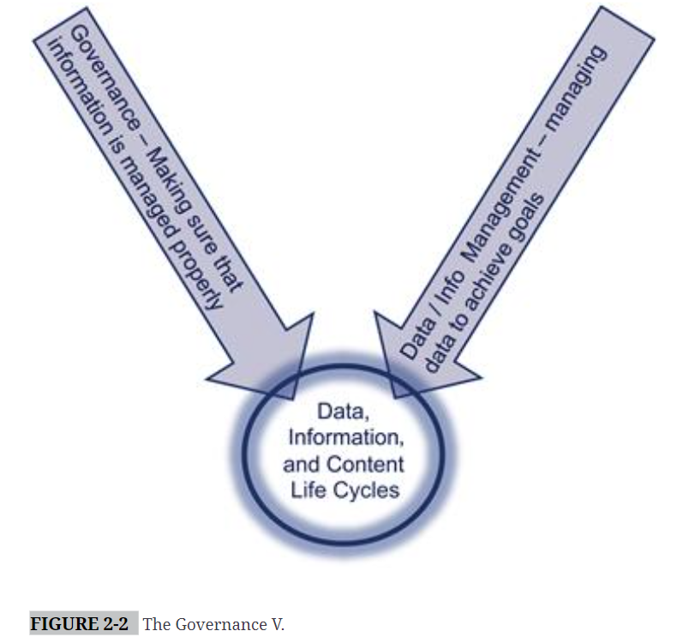
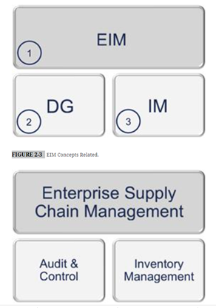
management of data X ensuring data is managed
“Data governance is the organization and implementation of policies, procedures, structure, roles, and responsibilities which outline and enforce rules of engagement, decision rights, and accountabilities for the effective management of information assets.”
Data governance is NOT a function performed by those who manage information.
The left side of the “V” id DG and the right side is Information Management (IM)
Ideally, there must always be a separation of duties between those who manage and those who govern
Parallel to managers and auditors
Notes:
The DG “area” identifies required controls, policies, and processes, and develops rules. Information managers (essentially everyone else) adhere to the rules.
EIM is the program that manages enterprise information assets to support the business and improve value.
EIM enterprise information management: manages the plans, policies, principles, frameworks, technologies, organizations, people, and processes in an enterprise toward the goal of maximizing the investment in data and content.

Slide 5
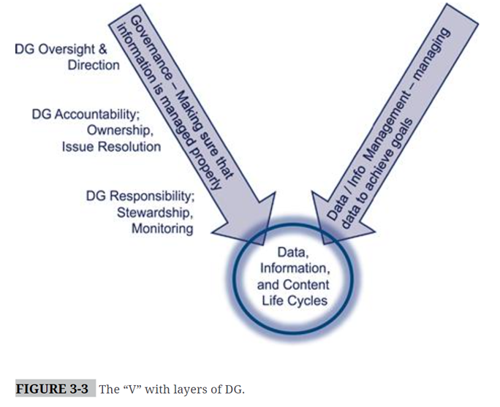
The Scope of Data Governance
• Business model—The type of organization, its corporate hierarchy, and its operating environment.
• Content being governed—The type of content (data, information, documents, etc.), its location, and its business relevance.
• Degree of federation—The extent or intensity by which different content is governed.
Assignment of DG roles
Notes:
Choose one group to present lab work

Slide 6
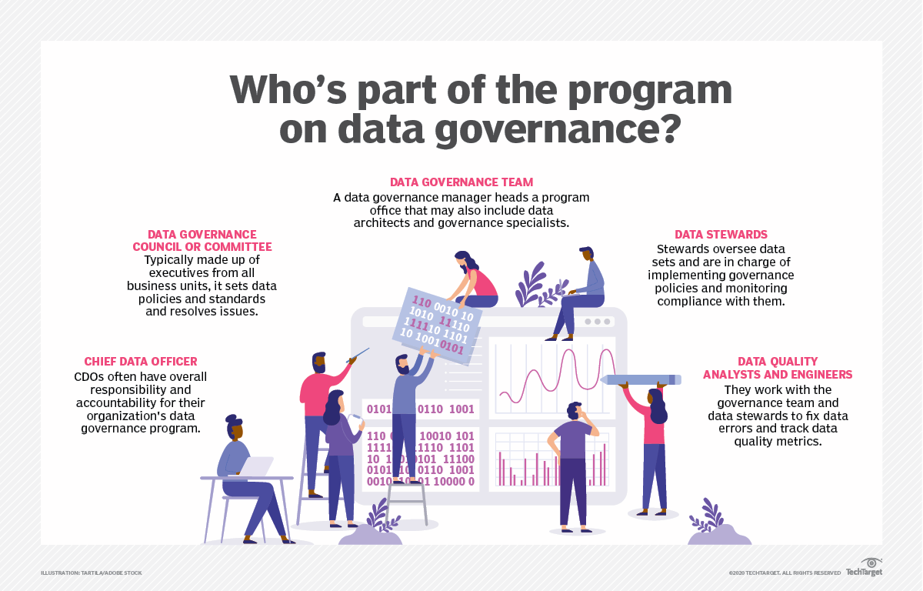
Who's responsible for data governance?
Notes:
Choose one group to present lab work

